Slide 1



SECURE DATA HIDING IN DIGITAL MEDIA USING HYBRID STEGANOGRAPHY TECHNIQUES
MATRUSRI ENGINEERING COLLEGE
Department of CSE
Mini Project
Batch:A1
J. Sai Chandana 1608-20-733-007
D.Manusha 1608-20-733-047
S.Sudeep 1608-20-733-301
Under the guidance of
Dr. L. Raghavendra Raju
Assistant Professor

Slide 2
CONTENTS
Introduction
Motivation
Abstract
Problem Statement
Literature Survey
Objectives
Proposed Methodology
Algorithm of Hybrid AES-RSA
Modules
System requirements
System Architecture
UML Diagrams
Test Cases
Results
Conclusion
Future Scope
References

Slide 3
INTRODUCTION
The increasing use of digital communication and storage has made it more critical than ever to ensure that sensitive information is protected from unauthorized access.
Traditional encryption techniques have been widely used for this purpose, but they can be vulnerable to attacks.
As a result, there is a growing need for alternative approaches to data protection that can provide a higher level of security.
Steganography is one such alternative technique that has gained attention in recent years.
Unlike encryption, steganography conceals the very existence of the secret message, making it harder for attackers to identify and extract the information.

Slide 4
MOTIVATION
Steganography has been used for thousands of years, dating back to ancient Greece and Rome, where people used hidden messages to pass information without detection. Today, steganography is still used for many reasons, including:
1. Military and intelligence operations
2.Cybersecurity
3.Copyright protection.
4.Personal privacy.
The motivation behind steganography is to provide a way for people to communicate and share information in a way that is secure, private, and undetectable to anyone who does not have the proper tools and knowledge to uncover the hidden message.

Slide 5
ABSTRACT
Steganography is the practice of hiding a message or information within another message or object, with the goal of concealing its existence.
It is a form of security through obscurity, where the message is kept secret by not drawing attention to its presence.
However, traditional steganography software can be inefficient and vulnerable to detection .
The proposed two-layered approach to steganography aims to address these limitations by combining the LSB algorithm and Hybrid RSA-AES, RC4 encryption techniques. This approach ensures that the information is well-hidden within digital content, while encryption provides an additional layer of protection to prevent unauthorized access.
Our proposed method Hybrid AES-RSA Encrypted LSB achieves an SSIM (Structural Similarity Index Measure) index of 0.9999 for images, 0.9773 for videos, and an RMS (Root Mean Square) value of 0.000178 for audio files.
The achieved accuracy is 97%, which is 13.25% higher than traditional LSB. These metrics demonstrate that the processed images, videos, and audio files closely resemble their originals.

Slide 6
PROBLEM STATEMENT
Traditional methods of data protection, such as encryption, have limitations that can be exploited by attackers.
Even though cryptography successfully transmits the secret information, it will give a suspicion to the hackers and affects unintended users.
There is a need for alternative techniques to protect sensitive information from unauthorized access in the digital world.
Steganography overcomes this factor and gives a solution for transmitting secret information with out affecting unintended users.
But the traditional steganography software has various limitations and maybe susceptible to detection by advanced steganalysis methods.
Traditional steganography also has limitations in terms of the file formats they support for hiding data. Some software may be designed specifically for images, while others may focus on audio or text files.
The limited range of compatible file formats can restrict the flexibility and applicability of the steganography software.

Slide 7
LITERATURE SURVEY
S. No | Author | Title | Methodology | Advantages | Limitations
1 | Prof. Samir Kumar, Bandyopadhya yBarnali, Gupta Banik | LSB Modification and Phase Encoding Technique of Audio Steganography Revisited | Least Significant Bit (LSB) Modification | It is observed that stego-file hasn’t been audibly modified. | 1.very susce-ptible to data loss due to channel noise and re-sampling. 2.Low transmission rate
2 | Shilpa Gupta , Geeta ujral, Neha Aggarwal | Enhanced Least Significant Bit algorithm For Image Steganography | Least Significant Bit (LSB) Modification | It minimizes the distortion level which is negligent to human eye. | Amount of data that can be hidden is drastically reduced.

Slide 8
S.No | Author | Title | Methodology | Advantages | Limitations
3 | Pooja Yadav , Nishchol Mishra , Sanjeev Sharma | A Secure Video Steganography with Encryption Based on LSB Technique | Least Significant Bit (LSB) Modification | In Proposed Work XOR transformation is used to encode the original information. | It can only hide a limited amount of data in the video frames.The process of embedding data in the LSB of the video frames can degrade the quality of the video, especially when high-capacity data is embedded.

Slide 9
OBJECTIVES
The primary objective of this project is to design and implement a reliable algorithm that can embed the secret data seamlessly into the carrier media, without degrading the quality or perceptual appearance of the media file.
The algorithm should ensure that the hidden data is resistant to various attacks, including statistical analysis, visual inspection, and steganalysis techniques.
To provide confidentiality to sensitive information. By embedding the information within a cover file, it is possible to protect the information from unauthorized access.
To prevent sensitive information from being intercepted or tampered with by unauthorized individuals. By hiding the information within a cover media, steganography provides an added layer of security as it is more difficult for attackers to detect the presence of hidden information.
Establish covert communication channels that are difficult to detect.

Slide 10
PROPOSED METHODOLOGY
Secret Information Selection : The sender chooses the secret information that needs to be protected and transmitted securely.
Encryption with RSA and AES : The secret information is encrypted using both RSA and AES algorithms.
Carrier File Selection :The sender selects an appropriate carrier file, which can be a text file, image, audio file, or video file.
LSB Steganography : LSB refers to a technique where secret information is concealed by replacing the least significant bits of a carrier file with the bits of the hidden message.
Key Storage : The encrypted symmetric key, public key, and private key are securely stored in a database.
Data Transmission : After embedding the encrypted information into the carrier file using the LSB steganography technique, the sender transmits the modified carrier file to the intended recipient through a secure channel.
Decryption and Extraction: The data is decrypted and displayed to the receiver.

Slide 11
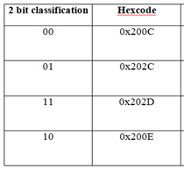
TEXT STEGANOGRAPHY
The abundance of textual information on the Internet has encouraged steganography to use this media as a carrier for hidden messages.
One approach to enable this technique is using Zero Width Characters (ZWC).
ZWC is a Unicode character (U+200B) that does not occupy any visible space or file formatting.
We take the encrypted secret message and get its ascii value and it is incremented or decremented based on if ascii value between 32 and 64 , it is incremented by 48(ascii value for 0) else it is decremented by 48
Then xor the the obtained value with 170(binary equivalent-10101010)
Convert the obtained number from first two step to its binary equivalent then add "0011" if it earlier belonged to ascii value between 32 and 64 else add "0110" making it 12 bit for each character.
With the final binary equivalent we also 111111111111 as delimiter to find the end of message
Now from 12 bit representing each character every 2 bit is replaced with equivalent ZWCs according to the table. Each character is hidden after a word in the cover text.

Slide 12
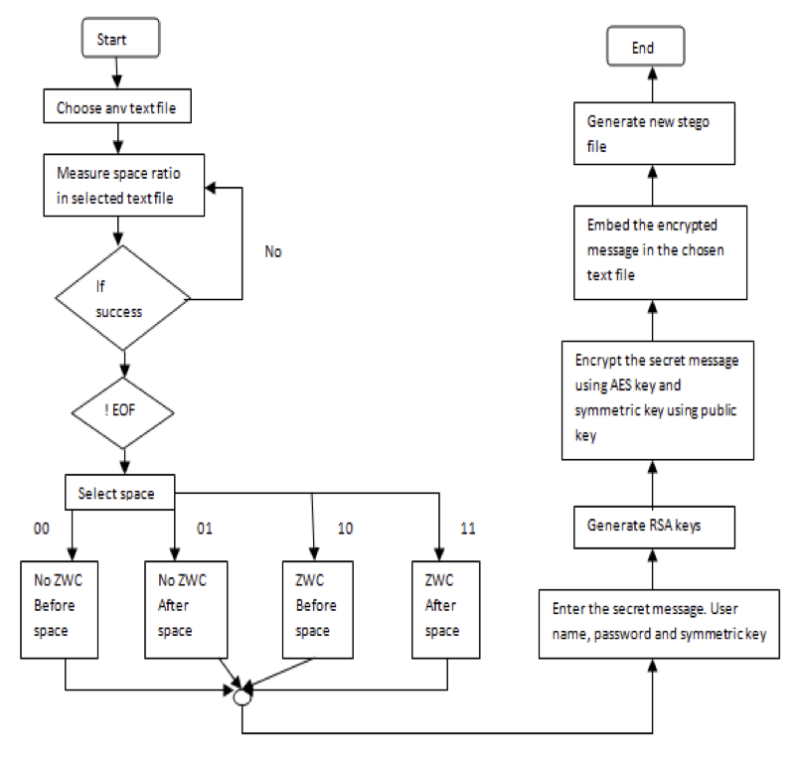

Slide 13
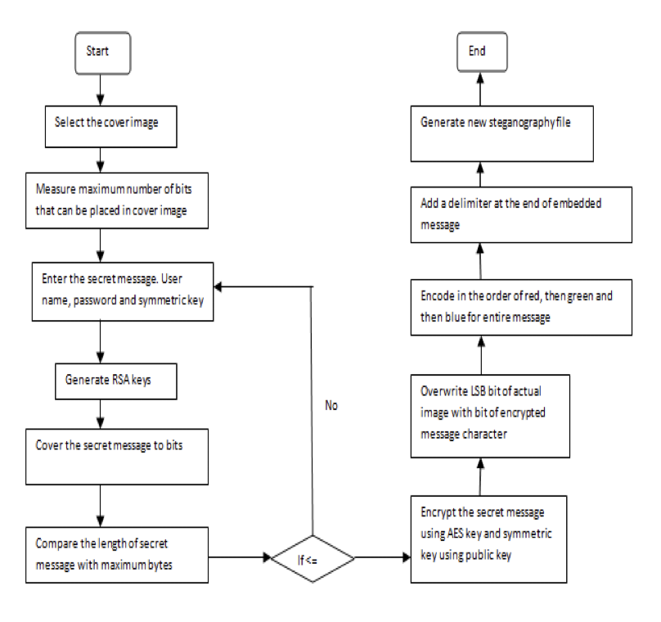
IMAGE STEGANOGRAPHY

Slide 14
AUDIO STEGANOGRAPHY
For encoding we have modified the LSB Algorithm, for that we take each frame byte of the converting it to 8 bit format.
Check the 4th LSB and see if it matches with the secret message bit.
If yes change the 2nd LSB to 0 using logical AND operator between each frame byte and 253(11111101).
Else we change the 2nd LSB to 1 using logical AND operation with 253 and then logical OR to change it to 1 and now add secret message bit in LSB for achieving that use logical AND operation between each frame byte of carrier audio and a binary number of 254 (11111110).
Then logical OR operation between modified carrier byte and the next bit (0 or 1) from the secret message which resets the LSB of carrier byte.

Slide 15
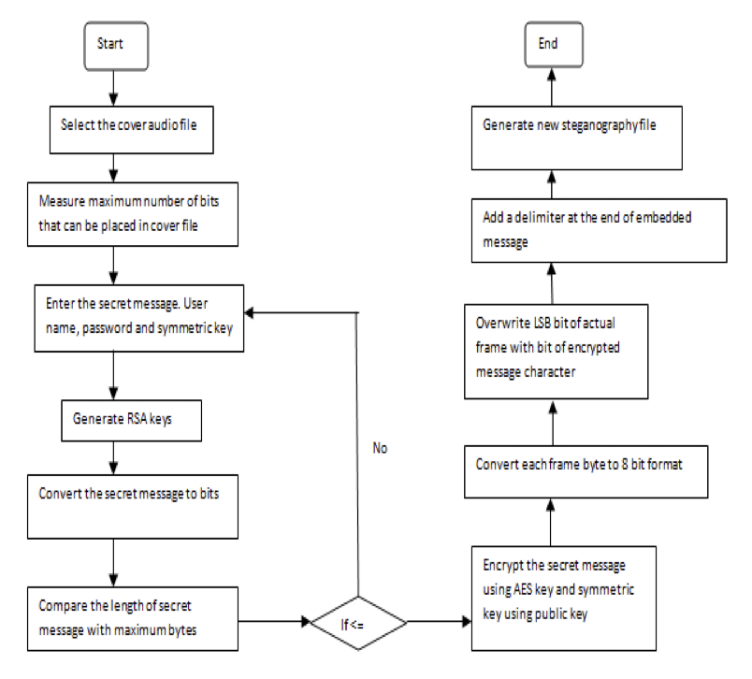

Slide 16
VIDEO STEGANOGRAPHY
We convert plaintext to cipher text for doing so we have used RC4 Encryption Algorithm. RC4 is a stream cipher and variable-length key algorithm. This algorithm encrypts one byte at a time. It has two major parts for encryption and decryption:-
KSA(Key-Scheduling Algorithm)- A list S of length 256 is made and the entries of S are set equal to the values from 0 to 255 in ascending order. We ask user for a key and convert it to its equivalent ascii code. S[] is a permutation of 0,1,2....255, now a variable j is assigned as j=(j+S[i]+key[i%key_length) mod 256 and swap S(i) with S(j) and accordingly we get new permutation for the whole key stream according to the key.
PRGA(Pseudo random generation Algorithm (Stream Generation)) - Now we take input length of plaintext and initiate loop to generate a key stream byte of equal length. For this we initiate i=0, j=0 now increment i by 1 and mod with 256. Now we add S[i] to j and mod of it with 256 ,again swap the values. At last step take store key stream bytes which matches as S[(S[i]+S[j]) mod 256] to finally get key stream of length same as plaintext.
Now we xor the plaintext with key stream to get the final cipher.

Slide 17
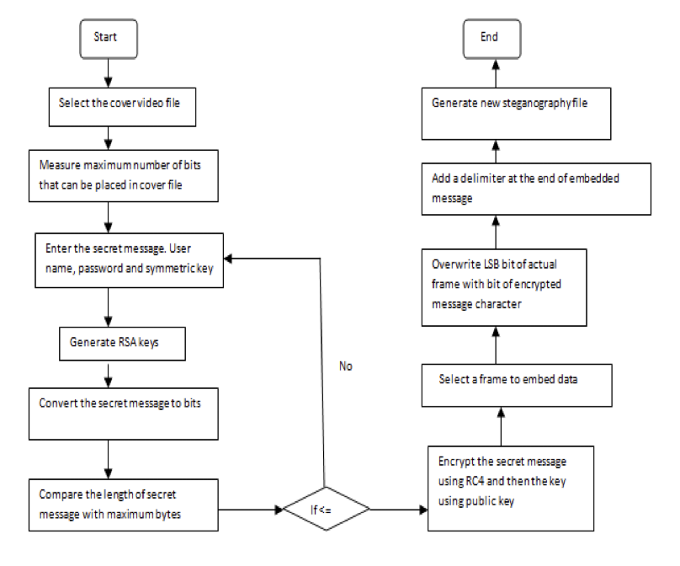

Slide 18
Algorithm for Hybrid AES-RSA
Algorithm for Hybrid AES-RSA Encryption
Input: Plain text, AES Symmetric key, RSA Public key
Output: Encrypted symmetric key, Cipher text
Begin Function hybridEncrypt(data, symmetricKey, rsaPublicKey):
encryptedData = aesEncrypt(data, symmetricKey)
//Encrypt the original data using AES encryption
encryptedSymmetricKey = rsaEncrypt(symmetricKey, rsaPublicKey)
//Encrypt the symmetric key using RSA public key
Return (encryptedSymmetricKey, encryptedData)
// Return the encrypted symmetric key and the encrypted data
End Function
Algorithm for Hybrid AES-RSA Decryption
Input: Encrypted AES Symmetric Key, RSA Private Key, Cipher text
Output: Plain text
Begin Function hybridDecrypt(encryptedSymmetricKey, rsaPrivateKey, encryptedData):
decryptedSymmetricKey = rsaDecrypt(encryptedSymmetricKey, rsaPrivateKey)
// Decrypt the encrypted symmetric key using RSA private key
decryptedData = aesDecrypt(encryptedData, decryptedSymmetricKey)
//Decrypt the cipher text using decrypted symmetric key
Return decryptedData
// Return the decrypted data as the final result.
End Function

Slide 19
Comparison of Data Hiding Techniques
Aspect | LSB Steganography | AES-RSA Encrypted LSB
Security | Low to Moderate | High
Encryption | No encryption. | AES is used for Symmetric encryption and RSA is used for Asymmetric encryption.
Data Integrity | Not ensured | Ensured
Steganalysis Resistance | Vulnerable | More resistant
Complexity | Simple | More Complex
Double-layered security | N/A | Yes
Applicability | Less secure applications. | More secure applications.

Slide 20
MODULES
Encryption Module
Hiding Module
Breaking Module
Decryption Module

Slide 21
SYSTEM REQUIREMENTS
Software Requirements: Technology : Python Libraries : numpy, pandas, os, openCV, matplotlib, rsa, cryptography, pycryptodome, psutil
Backend : sqlite
IDE :PyCharm
Hardware Requirements: RAM : Minimum 4GB Processor : Intel or Ryzen basic processor Memory : Minimum 2 GB free space

Slide 22
Module | Version
numpy | 1.25.1
pandas | 2.0.3
cryptography | 41.0.2
matplotlib | 3.7.2
openCV | 4.8.0.74
psutil | 5.9.5
pycryptodome | 3.18.0
dateutil | 2.8.2
scipy | 1.11.1
Modules with versions

Slide 23
DESIGN
System Architecture
UML Diagrams

Slide 24
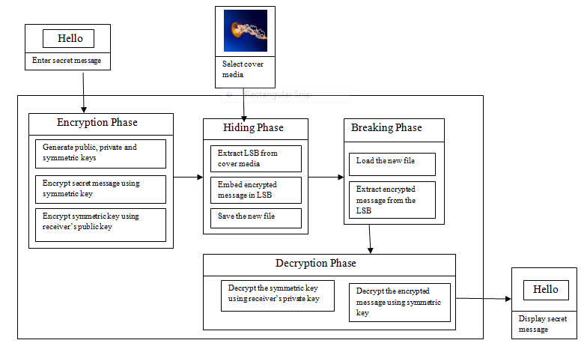
System Architecture

Slide 25
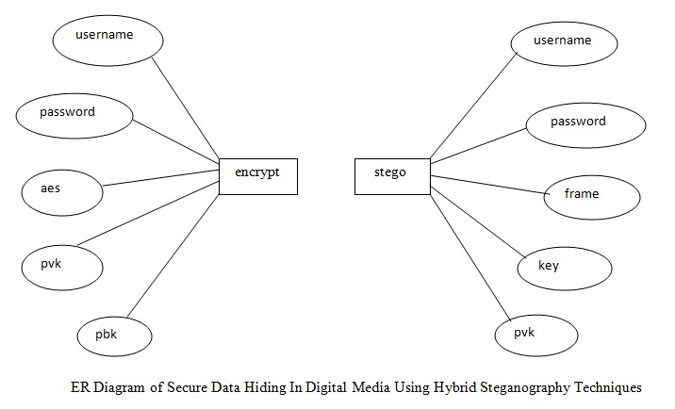
ER Diagram
An Entity-Relationship (ER) diagram is a graphical representation used in database design to model the logical structure of a database. It visually illustrates the entities, attributes, and relationships among entities in a clear and concise manner.

Slide 26
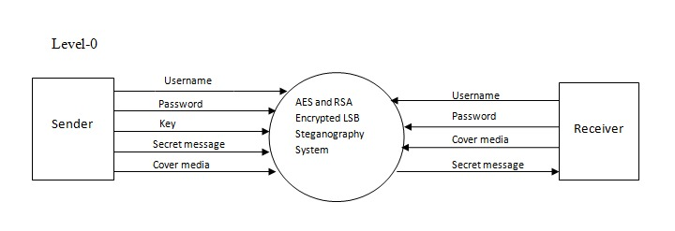
Data Flow Diagrams
The Context Level DFD provides an overview of the entire system and shows its interaction with external entities. It shows the major processes and data flows without diving into details.

Slide 27
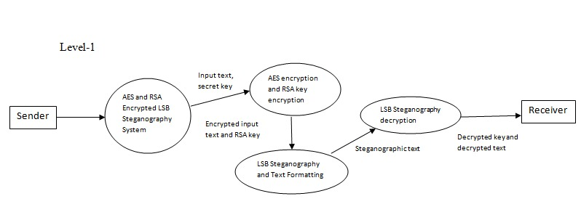
Level 1 DFDs break down the Context Level DFD into more detailed sub-processes. Each major process from the Context Level DFD is further decomposed into smaller processes each containing specific functions.

Slide 28
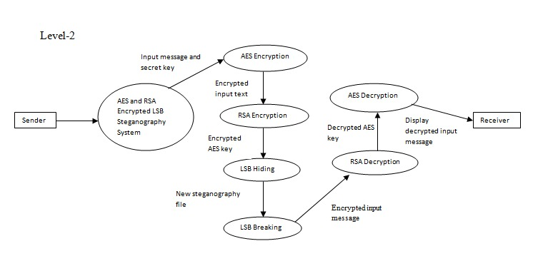
Level 2 DFDs further decompose the processes from Level 1 into even more detailed sub-processes. This level provides a more in-depth view of the data flow of the system and interactions among various processes in the system.

Slide 29
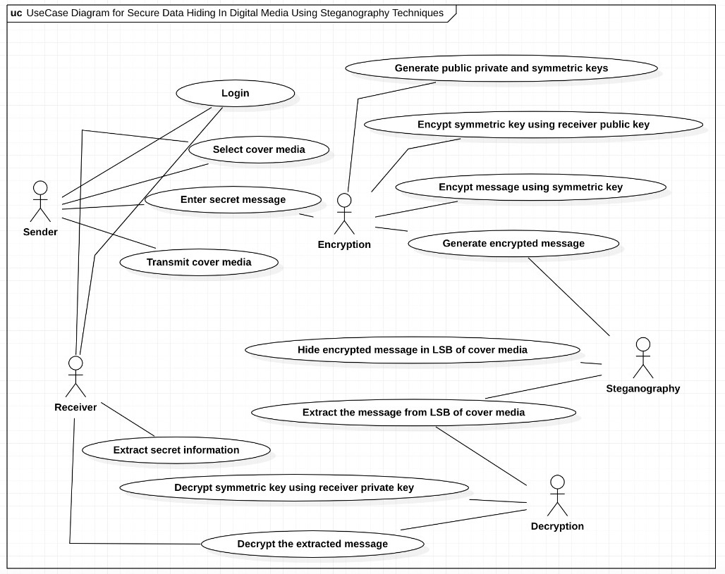
Use Case Diagram
A use case diagram at its simplest is a representation of a user's interaction with the system that shows the relationship between the user and the different use cases in which the user is involved. In this system, the use case diagram represents the primary actors as the sender , the receiver, encryption, decryption ans steganography. Each primary actor is represented with the respective functions that are defined inside the system scope.

Slide 30
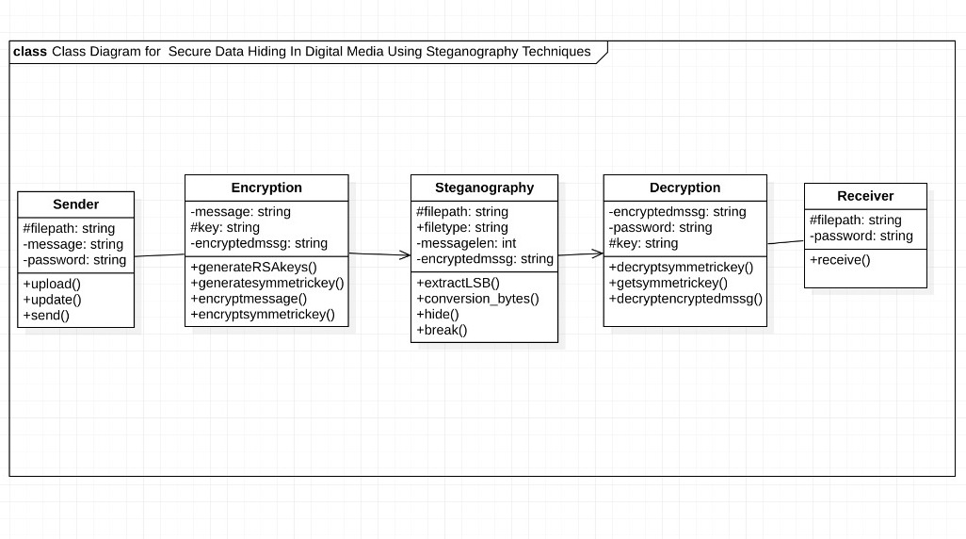
Class Diagram
The class diagram in the Unified Modelling Language (UML) is a type of static structure diagram that describes the structure of a system by showing the system's classes, their attributes, operations (or methods), and the relationships among objects. In this scenario, the system consists of following classes:Sender,Receiver,Encryption,Decryption and Steganography.

Slide 31
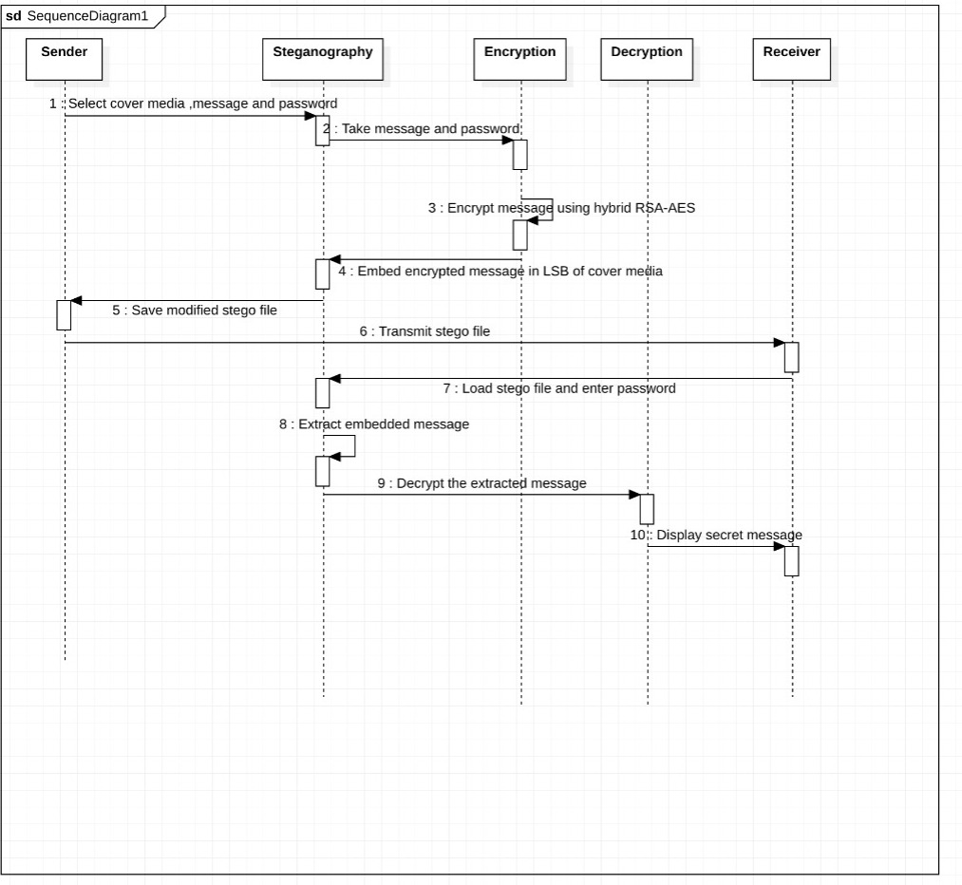
Sequence Diagram
A sequence diagram shows object interactions arranged in time sequence. It depicts the objects and classes involved in the scenario and the sequence of messages exchanged between the objects needed to carry out the functionality of the scenario.

Slide 32
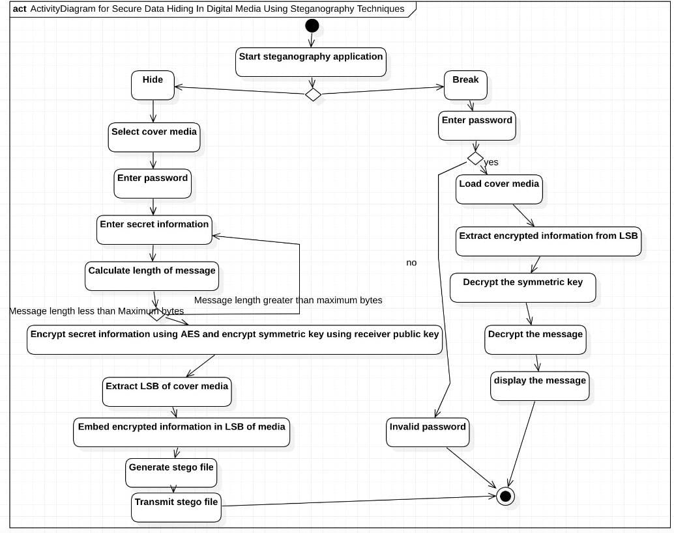
Activity Diagram
The activity diagram of the sender starts from the point of giving the inputs as key and the cover image and secret message to the system and terminates at the production of the output stego- hidden image. Similarly, the receiver side starts with the input as the stego-hidden image to the system and terminates at the display of the secret message.

Slide 33
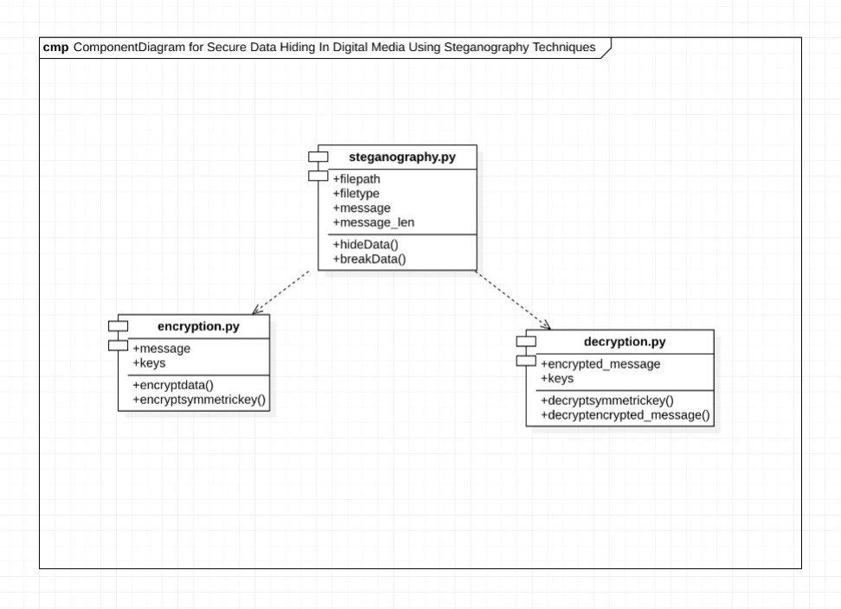
Component Diagram
A component diagram, also known as a UML component diagram, describes the organization and wiring of the physical components in a system. Component diagrams are often drawn to help model implementation details and double-check that every aspect of the system's required functions is covered by planned development.

Slide 34
TEST CASES

Slide 35
Test Case 1
Test Objective | Allow the users to encode the secret information of their choice of cover media
Test Description | The individuals choose a cover file to embed their secret information after entering the username, password and symmetric key.
Priority | High
Issues/Problems | Insufficient capacity
Expected Result | Embed the data into cover media and generate a new steganography file.
Actual Result | Data is embedded into cover media and new steganography file is generated
Result | Pass

Slide 36
Test Case 2
Test Objective | Allow the users with correct credentials to decode the secret information from cover media
Test Description | The individuals enter the username and password.If they match with the ones in database, they can access the secret message from cover file.
Priority | High
Issues/Problems | Deny the users with incorrect credentials
Expected Result | Display the secret message embedded in the cover media.
Actual Result | Secret message embedded in the cover media is displayed.
Result | Pass

Slide 37
RESULTS

Slide 38
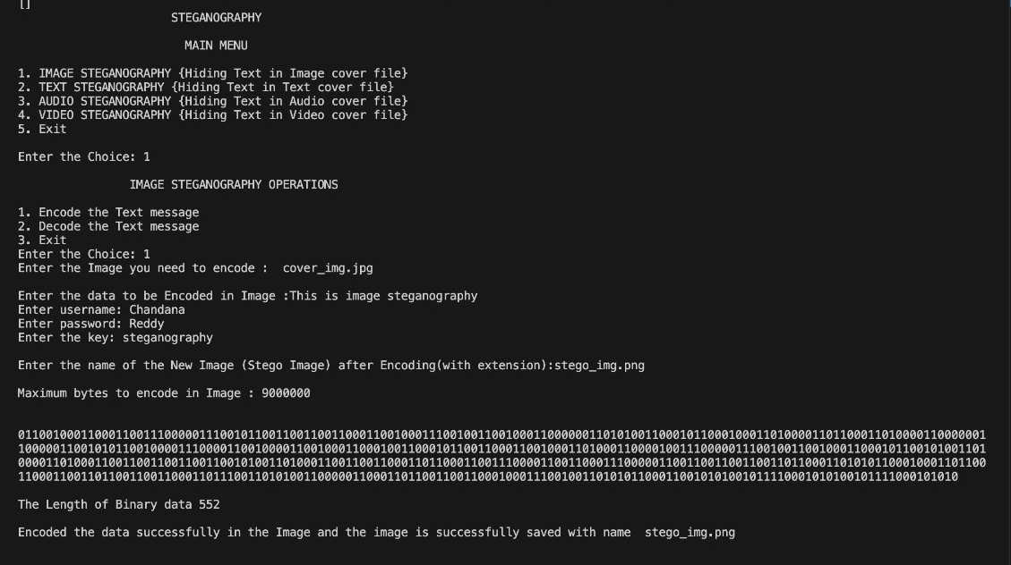
Image Steganography
Embedding the secret data in desired image

Slide 39
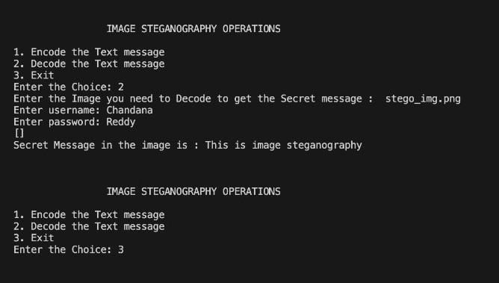
Extracting the secret data from image

Slide 40


Before embedding data
After embedding data
Similarity index(SSIM)=0.9999984079358767

Slide 41
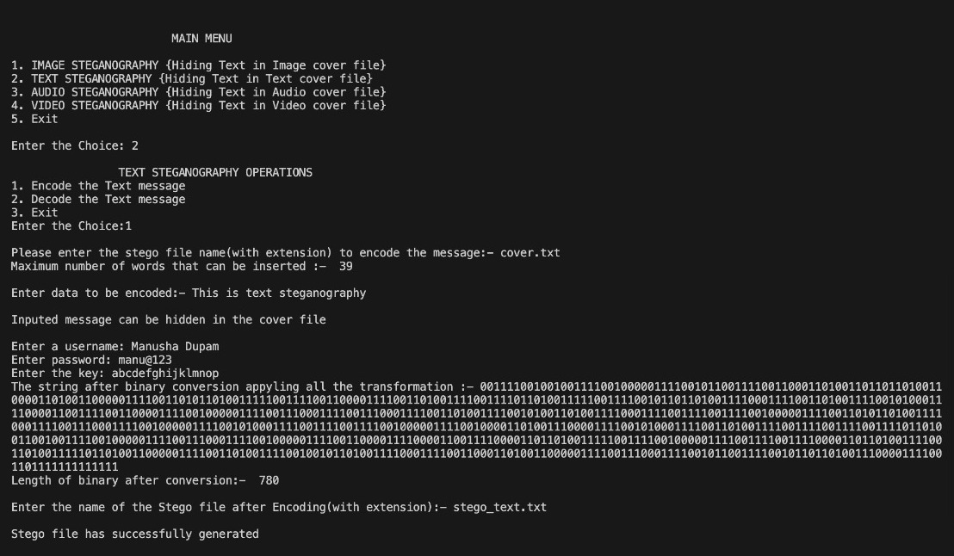
Text Steganography
Embedding the secret data in desired text file

Slide 42
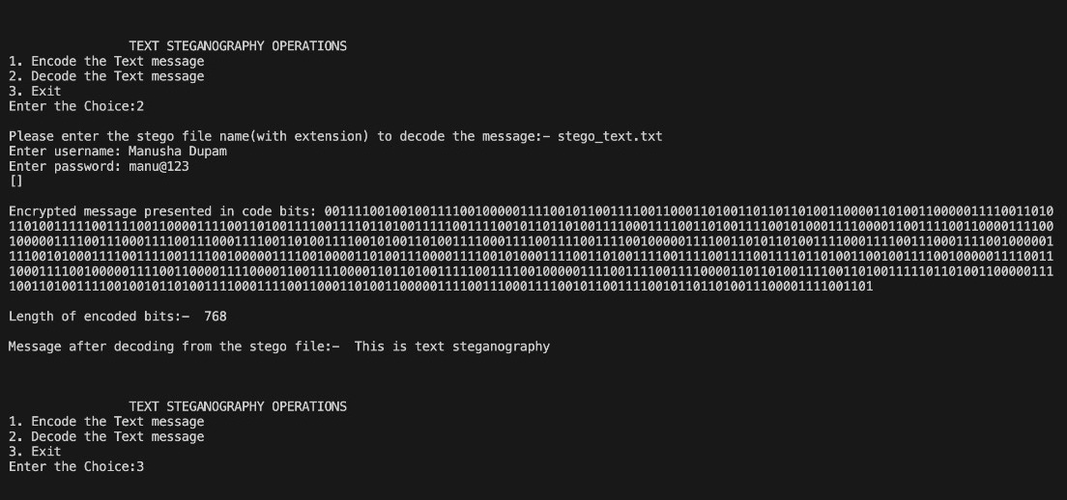
Extracting the secret data from the text file

Slide 43
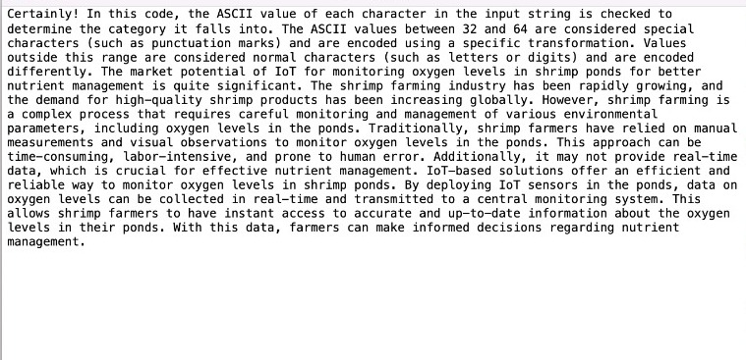
Before embedding
the data
After embedding
the data
Noise level (Levenshtein distance): 0.000

Slide 44
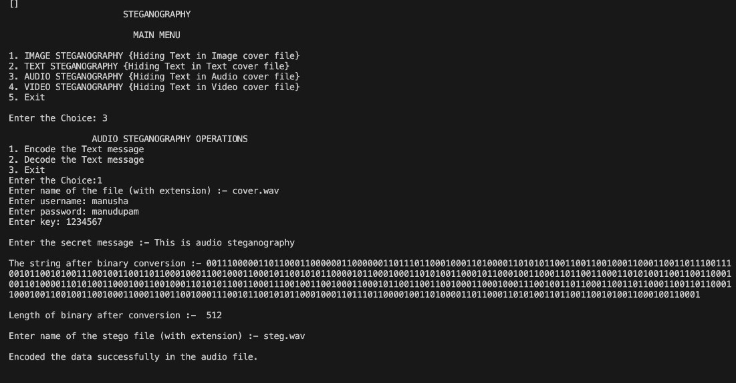
Audio Steganography
Embedding the secret data in desired audio file

Slide 45
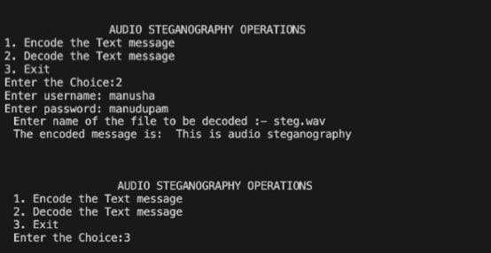
Extracting the secret data in desired audio file
Noise level(RMS): 0.00017853177604225116

Slide 46
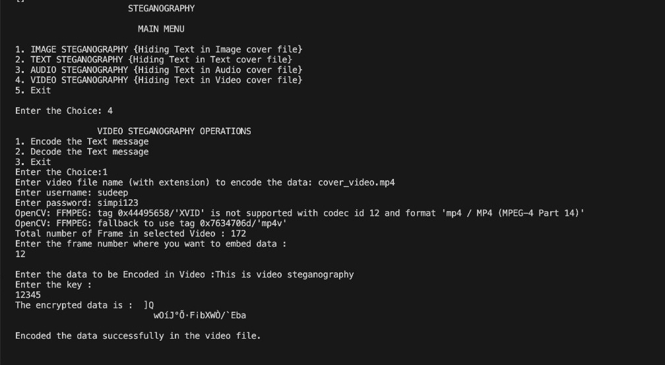
Video Steganography
Embedding the secret data in desired video file

Slide 47
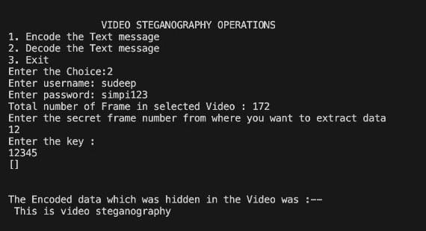
Extracting the secret data in desired video file
Structural Similarity (SSIM): 0.9773083891016694

Slide 48
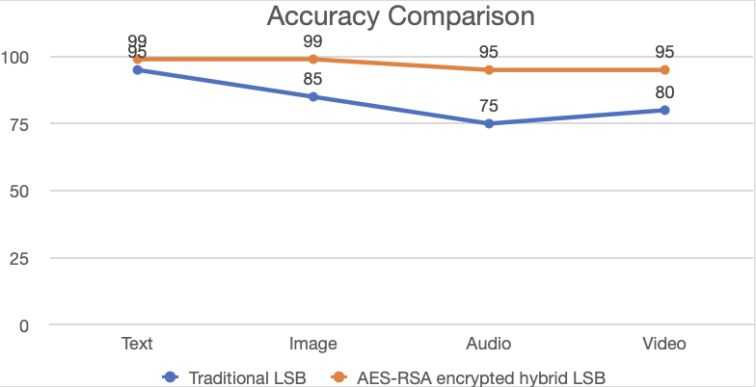
ACCURACY COMPARISON
Accuracy | Text | Image | Audio | Video
Traditional LSB | 90%-95% | 80%-85% | 70%-75% | 75%-80%
AES-RSA encrypted hybrid LSB | 95%-99% | 96%-99% | 90%-95% | 90%-95%

Slide 49
CONCLUSION
This project increases the performance of traditional steganography software by incorporating modern techniques.
The result is a robust and reliable tool designed to safeguard sensitive information by concealing it within seemingly innocuous files.
The primary objective of this project is to comprehensively incorporate contemporary security advancements while embracing the historical methodology of managing confidential communications.
The envisioned outcome is a powerful tool that empowers users to enhance the security of their private messages, effectively ensuring their confidentiality in network-based interactions.

Slide 50
FUTURE SCOPE
This project currently deals only with hiding text data in other multimedia formats such as image, audio and video.There is also a limit on the data that can be hidden in the cover media depending on it’s size.
The future work on this project is to hide all formats of secret messages in the cover media and increase the amount of data that can hidden in the media using compression.

Slide 51
REFERENCES
High Capacity data Hiding Using LSB Steganography And Encryption by
Shamim Ahmed Laskar and Kattamanchi Hemachandran
Enhanced Least Significant Bit algorithm For Image Steganography by Shilpa Gupta , Geeta Gujral and Neha Aggarwal
LSB Modification and Phase Encoding Technique of Audio Steganography Revisited by Prof. Samir Kumar, Bandyopadhyay Barnali, Gupta Banik
A Secure Video Steganography with Encryption Based on LSB Technique by Pooja Yadav , Nishchol Mishra , Sanjeev Sharma
Hiding Information in Digital Images Using LSB Steganography Technique by Sabah Abdulazeez Jebur, Abbas Khalifa Nawar, Lubna Emad Kadhim, Mothefer Majeed Jahefer

